Slide 1

Raising the bar: TPI’s new Management Quality framework An updated methodology and new assessment of 1,000+ companies
October 2023

Slide 2
Contents
Key insights and introduction
Key insights
Context: the TPI tool’s two pillars
Assessing Management Quality
Methodology v. 5.0: What’s new?
The new Level 5: transition planning and implementation
The new companies: expansion to over 1,000
Scope 3 applicability and changes to Level 4
Headline results
2023 results for the TPI universe
Management Quality level
Management Quality trends and progress
In-depth analysis
Indicator analysis
Level 5 review
Proportion of ‘Yes’ scores by sector and indicator
Sectoral deep-dive
Geographical deep-dive
About the Transition Pathway Initiative Centre

Slide 3
Key insights and introduction

Slide 4
Key insights – introducing the changes
TPI’s new, updated Management Quality framework (‘MQ version 5.0’) raises the bar by adding a Level 5.
Level 5 tests companies on whether they have transition plans that include defined, quantified and financed actions to get to net zero: giving greater insight into the rigour of companies’ transition plans and whether they are credibly implementing them.
We have increased the number of indicators in TPI’s MQ framework from 19 to 23. In keeping with our research philosophy, a considerable amount of effort has been devoted to selecting only the most relevant indicators, ensuring minimal data noise and a high degree of precision.
We now include a wider assessment of material Scope 3 emissions disclosure, with coverage extended to companies within the Food Producers, Diversified Mining and Chemicals sectors.
469 companies have been added to the TPI universe, taking the total number of listed companies covered by TPI’s MQ framework to 1,010. This is the largest ever expansion of the TPI company universe.
Level 5 data are available for all 1,010 companies.
The expansion in coverage now includes the addition of a new sector, Food Producers. This follows the successful trialling of a Carbon Performance methodology for food producing and processing companies. The sector consists of the largest 58 companies by free float market capitalisation (25 of which were previously covered by the TPI Centre in the Consumer Goods sector).
Notes:
Staircase
Sankey
Stairchart
- Be clear about expansion and new MQ (advertise what we have been busy with)
- Adding new level with x new indicators to abc
- deep dive into new indicators – potentially some of the older ones provided they are interesting (winners/losers, highest/lowest increase)
Keep to universe level insights rather than drilling down too much into sector/regional level
[Slide telling people where to find sector level analysis]?

Slide 5
Key insights – findings from this year’s assessment
No more than 5% of companies satisfy any MQ Level 5 indicator, and no company satisfies them all. This suggests that, while many companies are integrating climate change into operational decision-making and may be thinking about climate change strategically, credible transition planning and implementation remain scarce.
57% of TPI-assessed companies are on MQ Level 3 (Integrating climate change into operational decision making). 18% of companies are on Levels 0–2. This suggests that Level 3 functions as the new ‘par score’, indicating what may be considered normal. Companies that fall under this threshold can be considered laggards.
The decline in companies scoring on Levels 0–2 is a result of a marked year-on-year improvement. On net, 23% of companies assessed in both 2022 and 2023 have moved up at least one MQ level, reenforcing the need for new and more testing indicators.
While there is sectoral variation in MQ scores, there is no clear correlation between average MQ scores and the perceived difficulties faced in decarbonising different industrial sectors. For example, Airlines and Oil & Gas are two of the best performing sectors on MQ, despite being considered ‘difficult to decarbonise’. These difficulties, however, do show up in the realised and targeted real world Carbon Performance for companies in these sectors, as measured by the TPI Centre*.
Scores have an uneven geographical distribution: Australasian, European and Japanese firms score higher on both average MQ level and against the new Level 5 indicators than those headquartered in other regions. * For further information regarding companies’ Carbon Performance, please consult the TPI online tool.
Notes:
Staircase
Sankey
Stairchart
- Be clear about expansion and new MQ (advertise what we have been busy with)
- Adding new level with x new indicators to abc
- deep dive into new indicators – potentially some of the older ones provided they are interesting (winners/losers, highest/lowest increase)
Keep to universe level insights rather than drilling down too much into sector/regional level
[Slide telling people where to find sector level analysis]?

Slide 6
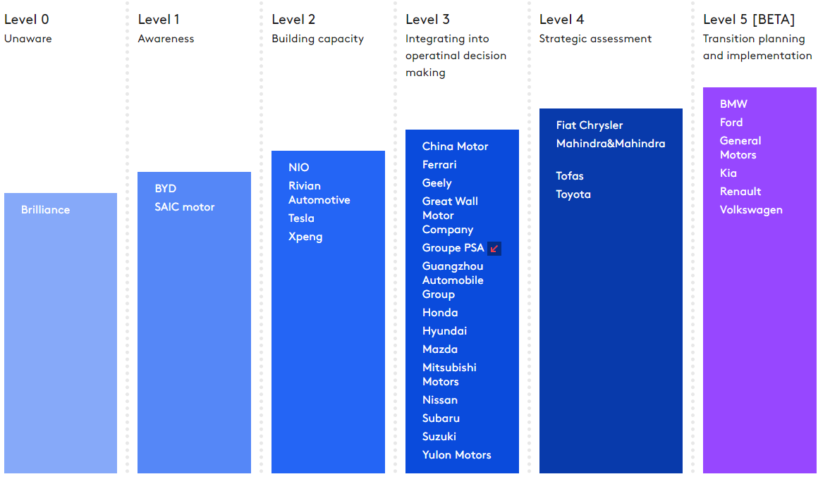
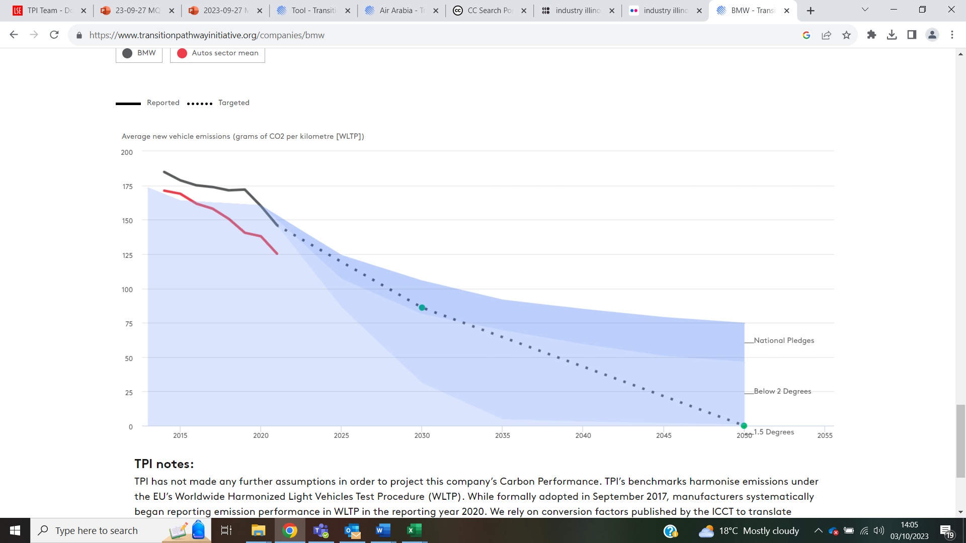
Context: the TPI tool’s two pillars
Management Quality
Companies’ governance of greenhouse gas emissions, and the risks and opportunities arising from the low-carbon transition.
Carbon Performance
Quantitative benchmarking of companies’ emission pathways against different climate scenarios.
Level 5 NEW [BETA]
More detail: TPI’s methodology report: Management Quality and Carbon Performance
More detail: TPI Explainer: Interpreting TPI’s emissions scenarios and benchmarks
Notes:
Update graphs

Slide 7

Assessing Management Quality
Level 0 Unaware | Level 1 Awareness | Level 2 Building capacity | Level 3 Integrating into operational decision making | Level 4 Strategic assessment | Level 5 [BETA] Transition planning and implementation
 |  |  |  |  | MQ19. Company quantifies the key elements of its emissions reduction strategy and the proportional impact of each action in achieving its targets MQ20. Company’s transition plan clarifies the role that will be played by offsets and/or negative emissions technologies MQ21. Company commits to phasing out capital expenditure in carbon intensive assets or products MQ22. Company aligns future capital expenditures with its long-term decarbonisation goals and discloses how the alignment is determined MQ23. Company ensures consistency between its climate change policy and the positions taken by trade associations of which it is a member
 |  |  |  | MQ13. Company has set long-term quantitative targets (>5 years) for reducing its GHG emissions MQ14. Company has incorporated climate change performance into executive remuneration MQ15. Company has incorporated climate change risks and opportunities in its strategy MQ16. Company undertakes climate scenario planning MQ17. Company discloses an internal carbon price MQ18. Company discloses the actions necessary to meet its emissions-reduction targets | Company’s transition plan clarifies the role that will be played by offsets and/or negative emissions technologies
 |  |  | MQ6. Company has nominated a board member/committee with explicit responsibility for oversight of the climate change policy MQ7. Company has set quantitative targets for reducing its GHG emissions MQ8. Company reports on its Scope 3 GHG emissions MQ9. Company has had its operational GHG emissions data verified MQ10. Company supports domestic & international efforts to mitigate climate change MQ11. Company has a process to manage climate-related risks MQ12. Company discloses materially important Scope 3 emissions | Company has incorporated climate change performance into executive remuneration | Company commits to phasing out investments in carbon intensive assets or products
 |  |  | Company has set quantitative targets for reducing its GHG emissions | Company has incorporated climate change risks and opportunities in its strategy | Company aligns future capital expenditures with its long-term decarbonisation goals and disclose how the alignment is determined
 |  | MQ4. Company has set GHG emission reduction targets MQ5. Company has published info. on its operational GHG emissions | Company reports on its Scope 3 GHG emissions | Company undertakes climate scenario planning | Company ensure consistency between its climate change policy and the positions taken by trade associations of which it is a member
 | MQ2. Company recognises climate change as a relevant risk/opportunity for the business MQ3. Company has a policy (or equivalent) commitment to action on climate change | Company has published info. on its operational GHG emissions | Company has had its operational GHG emissions data verified | Company discloses an internal carbon price
MQ1. Company does not recognise climate change as a significant issue for the business | Company has a policy (or equivalent) commitment to action on climate change |  | Company supports domestic & international efforts to mitigate climate change | Company disclose the actions necessary to meet its emissions-reduction targets
TPI’s MQ framework is based on a set of indicators, each of which tests whether a company has implemented a particular carbon management practice (Yes/No).
These indicators are used to map companies on to different levels.
Our new framework has 23 indicators, up from 19, and adds a sixth level.
The underlying data are provided by FTSE Russell, an LSEG business.

Slide 8
Methodology v.5.0: What’s new?

Slide 9
The new Level 5: Transition planning and implementation
Level 5 [BETA] Transition planning and implementation
MQ19. Company quantifies the key elements of its emissions reduction strategy and the proportional impact of each action in achieving its targets MQ20. Company’s transition plan clarifies the role that will be played by offsets and/or negative emissions technologies MQ21. Company commits to phasing out capital expenditure in carbon intensive assets or products MQ22. Company aligns future capital expenditures with its long-term decarbonisation goals and discloses how the alignment is determined MQ23. Company ensures consistency between its climate change policy and the positions taken by trade associations of which it is a member
Motivation for the new MQ level
New indicators are required as investors‘ focus shifts from ambition to action, and to provide greater differentiation of high-performing companies.
Since MQ v. 1.0 in 2017, expectations of corporate climate action have risen, and performance has improved. As more companies recognise the importance of robust carbon governance and management, previously stretching indicators are becoming standard practice.
Why the focus on transition plans?
MQ Level 5 assesses whether companies have used their strategic understanding of climate change to create an actionable transition plan that sets out the measures and resources needed to achieve the company’s emission targets. The five indicators included in Level 5 focus on the extent to which companies have evaluated and quantified how their business practices and capital expenditure align with their decarbonisation goals, and the subsequent clarity and precision of their transition plans.
As such, Level 5 gives greater insight into the rigour of companies’ transition plans and the associated likelihood of their implementation.

Slide 10
The new companies: expansion to over 1,000
Added companies: 469 companies have been added to the TPI company universe, taking the total number of listed companies covered by TPI’s MQ framework to 1,010. This is the largest ever expansion of the TPI company universe.
Added sector: We have added a new sector, Food Producers, following the successful trialling of a Carbon Performance methodology for the sector. It consists of 58 companies, 25 of which were previously covered by the TPI Consumer Goods sector.
High-emitting sectors: For each of the highest-emitting sectors, the TPI Centre now covers companies which together represent at least 90% of the total market capitalisation of that sector.
Size of companies: Within the high-emitting TPI sectors, where coverage is relatively saturated, new companies tend to be small- and mid-cap, while in the Other Industrials, Consumer Goods, and Services sectors, new companies are mainly large-cap.
Cluster | Sector | New companies | Total companies* | Market Cap (Share of total sector)
Energy | Electricity Utilities | 49 | 124 | 97%
 | Oil & Gas | 34 | 84 | 97%
 | Coal Mining | 11 | 54 | 100%
 | Oil & Gas Distribution | 8 | 25 | 100%
Transport | Airlines | 5 | 38 | 100%
 | Autos | 4 | 37 | 100%
 | Shipping | 5 | 31 | 100%
Industrials / Materials | Other Industrials | 82 | 116 | Not Applicable
 | Chemicals | 42 | 99 | 90%
 | Steel | 25 | 65 | 97%
 | Cement | 17 | 60 | 100%
 | Paper | 2 | 36 | 100%
 | Aluminium | 8 | 31 | 100%
 | Diversified Mining | 14 | 27 | 97%
Consumer goods and Services | Services | 82 | 88 | Not Applicable
 | Food | 33 | 58 | 90%
 | Consumer Goods | 48 | 54 | Not Applicable
*14 companies are assessed in more than one sector, so while TPI’s MQ framework covers 1,010 companies, there are 1,027 assessments

Slide 11
Scope 3 applicability and changes to Level 4
MQ12, on Scope 3 emissions disclosure, has been expanded. Before, it asked about use of sold product emissions only; now, it asks about materially important Scope 3 emissions more broadly. This indicator has thus been expanded to include more Scope 3 categories and to apply to more sectors, as highlighted in the table below.
MQ methodology v.5.0 also includes modifications to Level 4.
These are: i) a new indicator, MQ18, focusing on disclosure around emissions targets; ii) removal of an indicator on company membership of climate organisations/coalitions due to measurement challenges; and iii) moving a challenging indicator addressing trade association policy alignment to Level 5.
Cluster | Sector | Scope 3 Applicability
Energy | Coal Mining | Yes (use of sold products)
 | Electricity Utilities | None
 | Oil & Gas | Yes (use of sold products)
 | O&G Distribution | Yes (use of sold products)
Transport | Airlines | None
 | Autos | Yes (use of sold products)
 | Shipping | None
Industrials / Materials | Aluminium | None
 | Cement | None
 | Chemicals | Yes (purchased goods and services and use of sold products)
 | Diversified Mining | Yes (processing of sold products)
 | Other Industrials | None
 | Paper | None
 | Steel | None
Consumer goods and Services | Food Producers | Yes (purchased goods and services)
 | Consumer Goods | None
 | Services | None
Level 4: Strategic assessment
MQ13. Company has set long-term quantitative targets (>5 years) for reducing its GHG emissions MQ14. Company has incorporated climate change performance into executive remuneration MQ15. Company has incorporated climate change risks and opportunities in its strategy MQ16. Company undertakes climate scenario planning MQ17. Company discloses an internal carbon price MQ18. Company discloses the actions necessary to meet its emissions-reduction targets

Slide 12
Headline results

Slide 13
2023 results for the TPI universe
Level 0 Unaware |  | Level 1 Awareness |  | Level 2 Building capacity |  | Level 3 Integrating into operational decision making |  | Level 4 Strategic assessment |  | Level 5 Transition planning and implementation
 |  |  |  |  |  |  |  |  |  | 101 companies: 10%
 |  |  |  |  |  |  |  | 160 companies: 16% |  | 11 Consumer Goods & Services 43 Energy 36 Industrials & Materials 11 Transport
 |  |  |  |  |  | 583 companies: 57% |  | 35 Consumer Goods & Services 45 Energy 61 Industrials & Materials 19 Transport
 |  |  |  |  |  | 138 Consumer Goods & Services 137 Energy 261 Industrials & Materials 47 Transport
 |  |  |  | 95 companies: 9%
 |  | 79 companies: 8% |  | 6 Consumer Goods & Services 38 Energy 36 Industrials & Materials 15 Transport
9 companies: 1% |  | 10 Consumer Goods & Services 23 Energy 33 Industrials & Materials 13 Transport
0 Consumer Goods & Services 1 Energy 7 Industrials & Materials 1 Transport
Notes:
Food goes into consumer goods & services cluster

Slide 14

Management Quality level
The average MQ level of the new TPI universe is 3.1 (measured from Levels 0–5).
This is up from 2.9 in 2022, measured from Levels 0–4.
This means that, on average, companies have now integrated climate change into operational decision making (Level 3) but are still well short of strategic assessment (Level 4).
Ten per cent of companies reach Level 5.
There are important caveats to consider when comparing average MQ scores:
The addition of a new MQ Level 5 increases the maximum level companies can attain.
Changes to MQ Levels 3 and 4 have made it marginally more challenging for companies to progress.
There are important sectoral differences:
Cement and Coal Mining are notable laggards, with average MQ scores of 2.5 and 2.4, respectively.
At the other end of the spectrum is Other Industrials (comprising largely Industrial Engineering and Technology Equipment companies) with an average of 3.3 (See slide 20 for more details.)

Slide 15
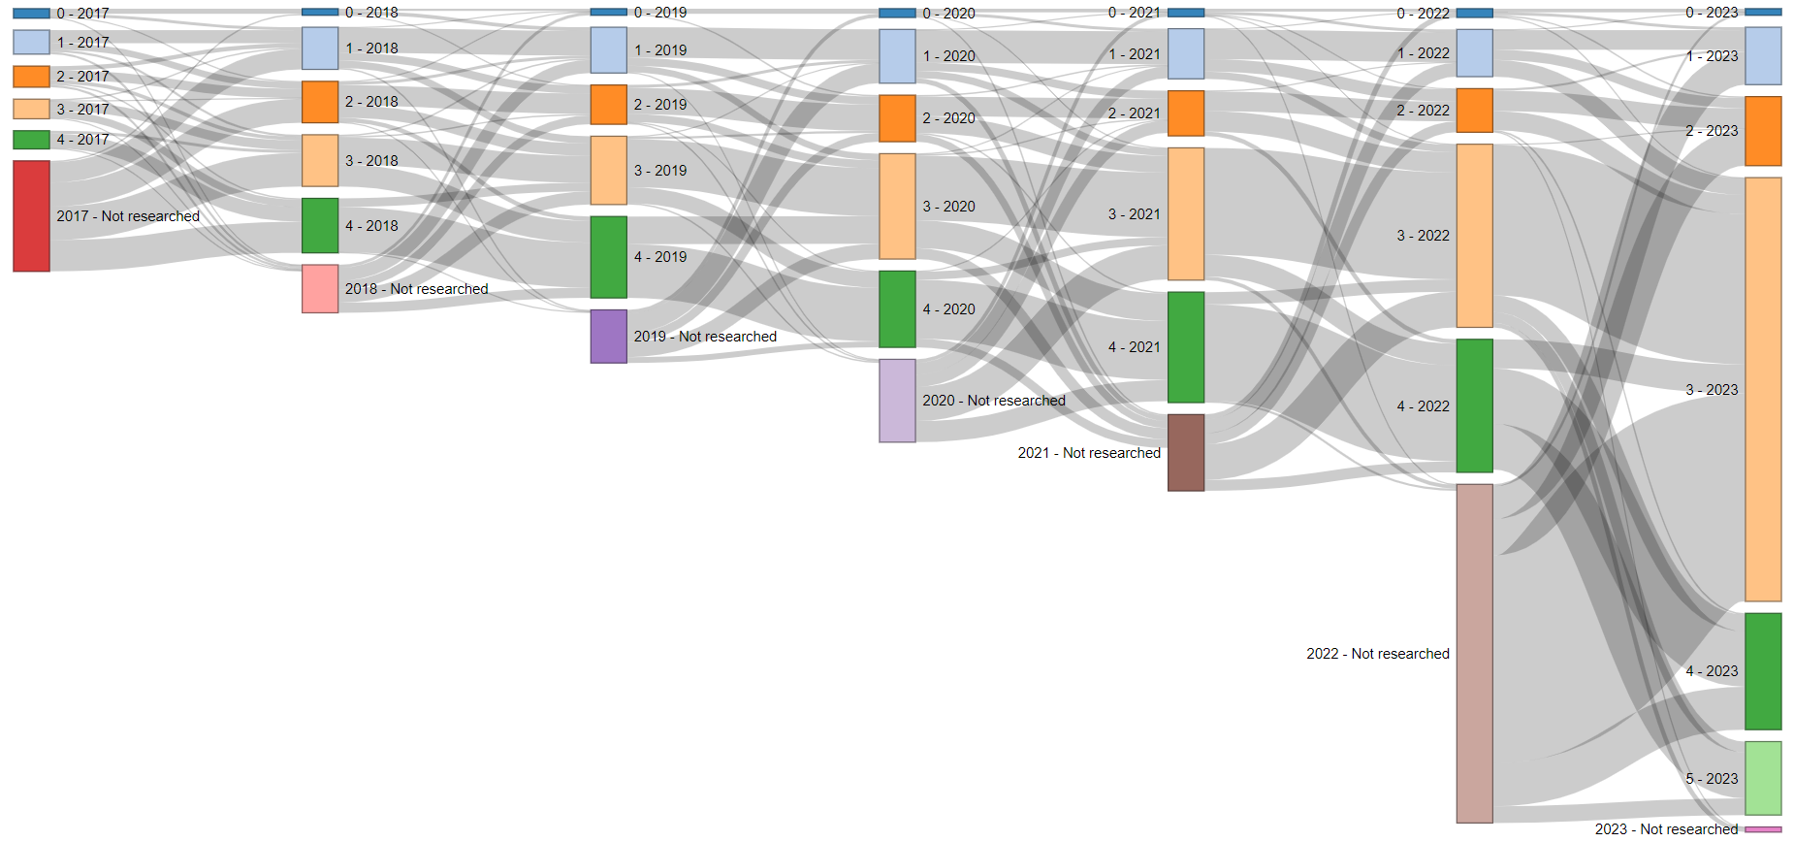
Management Quality trends and progress (1)
Nº companies=129
N=271
N=334
N=402
N=473
N=567
N=1,027
Distribution of companies across MQ levels, 2017–2023
This figure shows the number of companies reaching each MQ level between the years 2017 and 2023. The total number of companies assessed is provided at the top of each bar.
Notes:
TPI colour scheme
Highlight 2022-23 low light 2021 & earlier (Georgie)

Slide 16

Management Quality trends and progress (2)
We have trend data on 561 companies and most of those companies have been assessed at least three times. Current and historic data can be downloaded from the TPI online tool.
Overall, the distribution of companies across levels has moved upwards:
In 2017, companies were relatively evenly distributed across TPI’s then five MQ levels, 0–4. Now, 57% of companies are on MQ Level 3, and only 18% of companies are on Levels 0–2.
This suggests Level 3 functions as the new ‘par score’, indicating what may be considered normal. Companies that fall under this threshold can be considered laggards.
Levels 3–5 now account for 82% of companies.
Most companies (343) stay on the same level they were on in 2022:
More companies have moved up at least one level (173) than have moved down (45), with the upward trend being stronger this year than in 2022.
We see this trend despite changes to MQ Level 3 that have resulted in 40 companies moving from Levels 4 to 3.

Slide 17
In-depth analysis

Slide 18
Indicator analysis
Almost all companies acknowledge climate change (MQ1), recognise it as a relevant business risk/opportunity (MQ2), and have a policy commitment to act (MQ3). This holds true despite the addition of many smaller companies to the TPI universe.
More than four in five companies now have at least some form of GHG emission reduction target (MQ4).
Despite 83% of companies having assigned board-level responsibility for climate change (MQ6), only half of companies currently tie executive renumeration to climate change performance (MQ14).
Companies also struggle disproportionately on MQ10 (support for domestic/international climate action) and MQ12 (disclosure of material Scope 3 emissions).
New or updated MQ methodology version 5.0 indicators
Notes:
Background colour for level 5

Slide 19
Level 5: Transition planning and implementation
No company meets all Level 5 indicators and less than 5% score on any individual Level 5 indicator. Even in high-scoring sectors like Other Industrials and Electricity Utilities, only a handful of companies satisfy any Level 5 indicator. Thus, while these sectors are further along in their transition, they still appear to lack standout leaders or ’transition champions’.
Australasian-headquartered companies do notably well on MQ Level 5 indicators: MQ19 (15% score ‘Yes’), MQ22 (10% score ‘Yes’) and MQ23 (8% score ‘Yes’). Even European-headquartered companies, which are subject to increased climate reporting and accounting regulation, do less well.
The Diversified Mining sector is the clear leader on Level 5 indicators, scoring 9% on average across the level, ahead of Aluminium at 5%. Diversified Mining companies perform particularly well on MQ22 and MQ23, with 15% of companies scoring on both.
The only sector in which a quantified emission reduction strategy is somewhat common (MQ19) is Airlines, where more than 10% of companies have quantified the proportional impacts of their key actions in achieving their emission reduction targets.
NET= negative emissions technology
Notes:
Background colour for level 5

Slide 20
Proportion of ‘Yes’ scores by sector and indicator
 |  | Level 0 | Level 1 |  | Level 2 |  | Level 3 |  |  |  |  |  |  | Level 4 |  |  |  |  |  | Level 5 [BETA]
Sector | Mean Level | L0|1. Acknowl-edge? | L1|2. Recog-nises as risk/opp-ortunity? | L1|3. Policy commit-ment to act? | L2|4. Emissions targets? | L2|5. Disclosed Scope 1&2 emissions? | L3|6. Board respons-ibility? | L3|7. Quantitat-ive emissions targets? | L3|8. Disclosed any Scope 3 emissions? | L3|9. Had operation-al emissions verified? | L3|10. Support domestic and intl. mitigation? | L3|11. Process to manage climate risks? | L3|12. disclosure of materially important Scope 3 emissions? | L4|13. Long-term emissions targets | L4|14. Incorpor-ated climate change into exec. rem.? | L4|15. Climate risks/opp-ortunities in strategy? | L4|16. Undertakes climate scenario planning? | L4|17. Discloses an internal price of carbon? | L4|18. Discloses the actions to meet emissions-reduction targets? | L5|19. Quantifies the key elements of emissions reduction strategy? | L5|20. Clarifies the role that will be played by offsets and/or negative emissions technol-ogies? | L5|21. Commits to phasing out capital expend-iture in carbon intensive assets or products? | L5|22. Aligns future capital expend-itures with long-term decarbonisation goals? | L5|23. Ensures consist-ency between climate change policy and the trade associat-ions of which it is a member​?
Other Industrials | 3.5 | 100% | 100% | 100% | 98% | 100% | 98% | 98% | 91% | 81% | 38% | 95% | 23% | 98% | 68% | 63% | 53% | 45% | 52% | 2% | 2% | 2% | 0% | 3%
Electricity Utilities | 3.4 | 99% | 95% | 98% | 88% | 91% | 90% | 88% | 81% | 69% | 52% | 90% | NA | 85% | 62% | 57% | 63% | 52% | 52% | 4% | 2% | 7% | 2% | 2%
Oil & Gas | 3.3 | 100% | 100% | 99% | 89% | 94% | 88% | 88% | 68% | 71% | 43% | 88% | 40% | 86% | 56% | 35% | 58% | 39% | 48% | 7% | 4% | 0% | 0% | 6%
Consumer Goods | 3.3 | 100% | 96% | 100% | 96% | 98% | 89% | 96% | 93% | 89% | 30% | 89% | NA | 93% | 72% | 69% | 67% | 48% | 67% | 6% | 4% | 0% | 0% | 2%
Airlines | 3.2 | 97% | 92% | 97% | 76% | 89% | 79% | 76% | 66% | 61% | 47% | 79% | NA | 76% | 34% | 37% | 39% | 34% | 58% | 13% | 3% | 0% | 0% | 0%
Services | 3.2 | 100% | 99% | 98% | 94% | 98% | 92% | 93% | 89% | 75% | 36% | 91% | NA | 92% | 53% | 53% | 60% | 24% | 40% | 5% | 3% | 3% | 1% | 0%
Oil & Gas Distribution | 3 | 100% | 100% | 96% | 76% | 88% | 76% | 76% | 60% | 56% | 40% | 76% | 24% | 76% | 52% | 44% | 48% | 32% | 40% | 4% | 0% | 0% | 0% | 0%
Chemicals | 3 | 99% | 92% | 99% | 94% | 96% | 86% | 93% | 79% | 68% | 37% | 86% | 26% | 90% | 56% | 65% | 57% | 52% | 53% | 6% | 2% | 1% | 0% | 1%
Autos | 2.9 | 100% | 86% | 100% | 76% | 92% | 78% | 76% | 70% | 59% | 32% | 78% | 51% | 73% | 35% | 54% | 57% | 32% | 46% | 5% | 0% | 3% | 0% | 8%
Aluminium | 2.9 | 97% | 81% | 94% | 77% | 87% | 65% | 77% | 52% | 55% | 35% | 68% | NA | 77% | 39% | 19% | 55% | 29% | 45% | 6% | 0% | 3% | 6% | 6%
Steel | 2.9 | 100% | 94% | 97% | 77% | 94% | 82% | 77% | 68% | 58% | 18% | 77% | NA | 77% | 37% | 38% | 52% | 34% | 46% | 6% | 2% | 0% | 2% | 3%
Diversified Mining | 2.9 | 100% | 93% | 100% | 78% | 93% | 89% | 78% | 74% | 70% | 30% | 85% | 37% | 70% | 48% | 37% | 63% | 44% | 52% | 7% | 4% | 4% | 15% | 15%
Food Producers | 2.9 | 100% | 92% | 100% | 90% | 95% | 80% | 90% | 73% | 53% | 12% | 80% | 54% | 80% | 37% | 44% | 37% | 20% | 34% | 5% | 0% | 2% | 0% | 0%
Shipping | 2.8 | 100% | 81% | 100% | 81% | 77% | 68% | 81% | 55% | 65% | 19% | 61% | NA | 81% | 23% | 32% | 45% | 23% | 42% | 0% | 0% | 3% | 0% | 0%
Paper | 2.8 | 100% | 83% | 100% | 75% | 81% | 75% | 72% | 61% | 50% | 28% | 67% | NA | 67% | 33% | 36% | 50% | 31% | 28% | 3% | 11% | 0% | 0% | 0%
Cement | 2.6 | 92% | 80% | 92% | 62% | 80% | 60% | 62% | 53% | 52% | 27% | 55% | NA | 58% | 37% | 38% | 35% | 32% | 33% | 8% | 0% | 2% | 0% | 3%
Coal Mining | 2.4 | 100% | 72% | 100% | 54% | 80% | 65% | 54% | 41% | 46% | 20% | 59% | 17% | 50% | 30% | 20% | 26% | 22% | 31% | 7% | 4% | 0% | 4% | 4%
TOTAL TPI UNIVERSE | 3.1 | 99% | 92% | 98% | 84% | 92% | 83% | 84% | 73% | 66% | 34% | 81% | 36% | 82% | 50% | 48% | 52% | 37% | 46% | 5% | 2% | 2% | 1% | 3%

Slide 21

Sectoral deep-dive
There is no clear relationship between how difficult it is to decarbonise a sector and its TPI MQ Level. For example, Paper companies score poorly on average, but Airlines and Oil & Gas companies score well, even though the Paper sector faces fewer barriers to decarbonisation.
While roughly half of assessed Electricity Utilities and Airlines support domestic and international policies to address climate change, support from companies in other sectors is typically much lower (especially in the Steel and Food Producer sectors).
Only 35% of Autos manufacturers tie a proportion of executive remuneration to achieving their emission reduction targets (compared with 45% across the entire TPI universe, and 62% in electricity utilities), despite the accelerated move from the internal combustion engine to electric vehicles.
Coal Mining companies score poorly on average because only just over half (54%) have set an emission reduction target, leaving 50% of companies on Level 1 or Level 2.
The Food Producer sector is the best performer on MQ12, disclosure of materially important Scope 3 emissions, despite it being notoriously difficult to calculate emissions for food product supply chains.

Slide 22
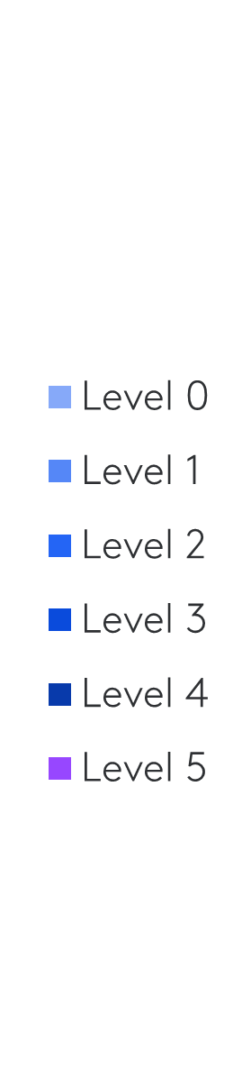

Geographical deep-dive
There is clear outperformance on MQ scores by European companies, 46% of which score on Levels 4–5. By way of comparison, only 24% of North American companies score on these levels.
Within Asia, 24% of Japanese companies score on Levels 4–5; 19% score on these levels in ’Other Asia’ (Asia excluding Japan and China) and 2% do so in China.

Slide 23
About the LSE Transition Pathway Initiative Centre
The Transition Pathway Initiative Centre (TPI Centre) is an independent, authoritative source of research and data on the progress of corporate and sovereign entities in transitioning to a low-carbon economy.
The TPI Centre is part of the Grantham Research Institute on Climate Change and the Environment which is based at the London School of Economics and Political Science (LSE). The TPI Centre is the academic partner of the Transition Pathway Initiative (TPI), a global initiative led by asset owners and supported by asset managers. As of October 2023, 143 investors globally, representing around US$60 trillion combined Assets Under Management and Advice, have pledged support for TPI.
Using companies’ publicly disclosed data, the TPI Centre:
Assesses the quality of companies’ governance and management of their carbon emissions and of risks and opportunities related to the low-carbon transition, in line with the recommendations of the Task Force on Climate-related Financial Disclosures (TCFD).
Assesses whether companies’ current and planned future emissions are aligned with international climate targets and national climate pledges, including those made as part of the Paris Agreement.
Provides the data for the Climate Action 100+ Net Zero Company Benchmark.
Publishes its methods and results online and fully open access at www.transitionpathwayinitiative.org and on GitHub.

Slide 24
Disclaimer
Data and information published in this presentation and on the TPI website is intended principally for investor use but, before any such use, you should read the TPI website terms and conditions to ensure you are complying with some basic requirements which are designed to safeguard the TPI and the TPI Centre whilst allowing sensible and open use of TPI data. References in these terms and conditions to “data” or “information” on the website shall include the carbon performance data, the management quality indicators or scores, and all related information.
By accessing the data and information published on this website, you acknowledge that you understand and agree to these website terms and conditions. In particular, please read paragraphs 4 and 5 below which details certain data use restrictions.
The data and information provided by the TPI Centre can be used by you in a variety of ways – such as to inform your investment research, your corporate engagement and proxy-voting, to analyse your portfolios and publish the outcomes to demonstrate to your stakeholders your delivery of climate policy objectives and to support the TPI in its initiative. However, you must make your own decisions on how to use TPI data as the TPI Centre cannot guarantee the accuracy of any data made available, the data and information on the website is not intended to constitute or form the basis of any advice (investment, professional or otherwise). The TPI and the TPI Centre do not accept any liability for any claim or loss arising from any use of, or reliance on, the data or information. Furthermore, the TPI does not impose any obligations on supporting organisations to use TPI data in any particular way. It is for individual organisations to determine the most appropriate ways in which data and information from the TPI Centre can be helpful to their internal processes.
Subject to paragraph 3 above, the Management Quality and the Carbon Performance indicators that are part of the TPI online tool and available publicly on the TPI Centre’s website are:
Free, if they are used for internal and not for commercial purposes, including for research, as one of the inputs to inform portfolio construction, for financial decision-making including cases of lending and underwriting, for engagement and client reporting, for use in proprietary models as part of climate transition analysis and active investment management.
Restricted, unless licensed where the use is for further commercial exploitation through redistribution, derived data creation, analytics, and index or fund creation (inclusive of where the index is used as the basis for the creation of a financial product, or where TPI data is a key constituent of a fund’s construction).
Notwithstanding any other provision of these website terms and conditions, none of the data or information on the website may be reproduced or made available by you to any other person except that you may reproduce an insubstantial amount of the data or information on the website for the uses permitted above.
The data and information on the website may not be used in any way other than as permitted above. If you would like to use any such data or information in a manner that is not permitted above, you will need TPI’s written permission. In this regard, please email all inquiries to info@tpi.org.

Slide 25
About the Authors
Valentin Jahn is the Lead Research Analyst at the LSE-TPI Centre.
Robert Ingham is an Analyst and Policy Officer at the LSE-TPI Centre.
Simon Dietz is the Research Director at the LSE-TPI Centre and a Professor of Environmental Policy at the London School of Economics and Political Science, Department of Geography and Environment.
www.transitionpathwayinitiative.org
Contact:
General initiative inquiries: info@transitionpathwayintiative.org
Research-related inquiries: tpi@lse.ac.uk

